Slide 1

Module 3.5
Application Structure

Slide 2
Application structure
Notes:
This page intentionally blank

Slide 3
Overview
Application management
  Single station but multi-instance software
  Complete application saved in a single file (*.STU)
  Version number management
Software structure
  Tasks (single or multi task, ....)
  Sections and subroutines
  Functional modules
Import / Export of "Program source"
  Partial or total (one or more sections, an entire application, ...)
Protection
  Partial or total (one or more sections, an entire application)
Program analysis

Slide 4
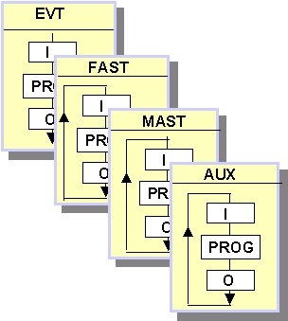
Software structuration
In different tasks
  Single task : main task (MAST)
  Multitask : MAST + fast task (FAST) + auxiliary tasks (AUX)
  Event tasks : EVT or TIMER
In execution mode
  Cyclic execution
  Periodic execution
In sections
  Tasks structured into sections
In Subroutine - SR
  In MAST, FAST and AUX tasks , sections may call up to subroutines

Slide 5
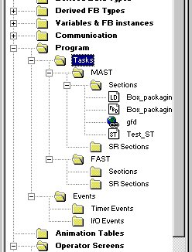
Tasks
MAST : main task
  Made up of sections & subroutines
  Programmed in LD, FBD, IL, ST or SFC
  Cyclic or periodic execution (0..255 ms, 0 = cyclic operation)
  Controlled by watch dog, system bits & words
FAST : fast task
  Made up of sections & subroutines
  Programmed in LD, FBD, IL, ST
  Periodic execution (1..255 ms)
  Controlled by watch dog, system bits & words
Notes:
MAST task
System objects Description
%SW0 Task period
%S30 Master task activation
%S11 Watchdog error
%S19 Period overrun
%SW30 Execution time (in ms) of the last cycle
%SW31 Execution time (in ms) of the longest cycle
%SW32 Execution time (in ms) of the shortest cycle
FAST task
System objects Description
%SW1 Task period
%S31 Fast task activation
%S11 Watchdog error
%S19 Period overrun
%SW33 Execution time (in ms) of the last cycle
%SW34 Execution time (in ms) of the longest cycle
%SW35 Execution time (in ms) of the shortest cycle

Slide 6
Tasks (cont'd)
EVT or TIMER : event tasks
  Allow to reduce the response time of the application program to events from input/output modules, event timers
  Single section programmed in LD, FBD, IL, ST
  EVTi : events coming from input/output modules
  TIMERi : events coming from event timers (ITCNTRL function)
AUX : auxiliary tasks
  Intended for slower processing tasks
  Possible to program up to 4 auxiliary tasks (AUX0 to AUX3) on the Premium TSX P57 5•• and Quantum 140 CPU 6••••
  Made up of sections & subroutines
  Programmed in LD, FBD, IL, ST
  Periodic execution (from 10 ms to 2.55 s)
Notes:
EVT-type event coming from input/output modules and expert modules:
Quantum :
. Interrupt module (140HLI340 00)
Premium :
. Input/output modules (TSXDEY6FK and TSXDMY28FK)
. All counting modules
. All axis control modules
. All electronic cam modules

Slide 7
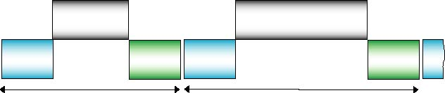
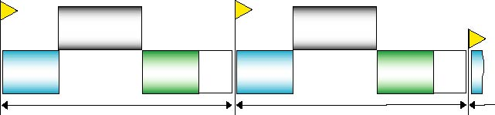
Execution mode
Cyclic
Program
handling
Program
handling
Read
Inputs
Write
Outputs
Read
Inputs
Write
Outputs
Cycle n
Cycle n+1
S.P. = System Processing (House keeping)
Periodic
Program
handling
Program
handling
Read
Inputs
Write
Outputs
Read
Inputs
Write
Outputs
S.P.
S.P.
Period
Period

Slide 8
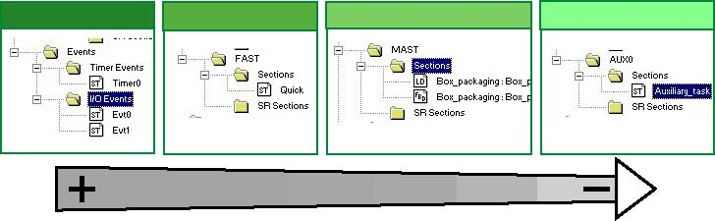
Multitask
Multitask = MAST and (FAST or EVT or AUX)
Priorities of tasks
Event tasks
Fast task
Mast task
Auxiliary tasks
Notes:
Available tasks and processing

Slide 9
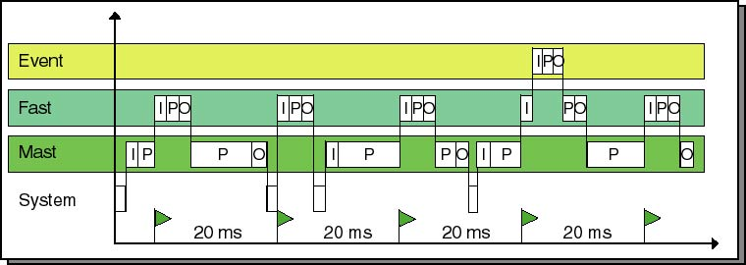
Multitask (con't)
Execution
Example cyclic master task, periodical Fast task (period = 20 ms)

Slide 10
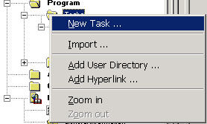
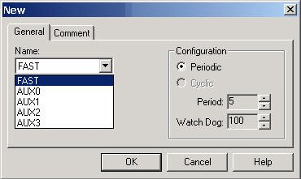
Operating Mode
New task
  Selection "Task" folder
  Right-click => New Task
  Select the type (Fast or Auxi)
  Select the period and the watchdog
  Confirm all entries using OK
Note : If using an AUX task, MAST task
must be periodic

Slide 11
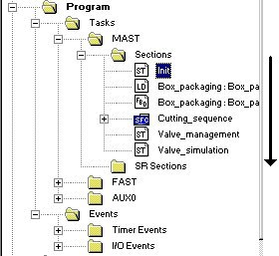
Sections
Each task can be made up of a number of sections
  unlimited
Attributes associated with a Section
  Name : 32 characters maximum (accents are possible, but spaces are forbidden)
  Language : LD, FBD, IL, ST or SFC
  Associated task : Mast, Fast, Event, Aux, SR
  Condition (optional) : validation bit to execute, configured directly
  Comment : 256 characters maximum
  Protection : Write-protection, read/write protection
Order of execution of Sections :
  order in which they appear in the browser

Slide 12
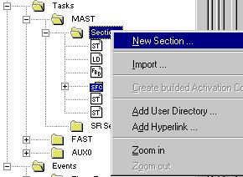
Operating mode
New section
  Select "section" folder
  Right-click => New Section
  Enter the parameters
  Confirm all entries using OK
Utilities
  Import a section
  Export a section (select the section to be exported)
  Delete a section (select the section to be deleted)

Slide 13
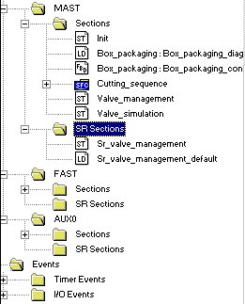
Subroutines
Programmed as separate entities, either in LD, IL, ST, FBD
The calls to subroutines are carried out in the sections or from another subroutine
The number of nestings is limited to 8. A subroutine cannot call itself (non recursive).
Linked to a task, the same subroutine cannot be called from several different tasks

Slide 14
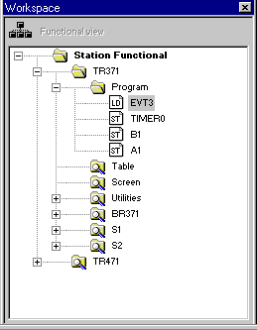
Functional Approach
Structuring of the PLC project in direct relation to the organization of the process :
  Tree structure of functional modules
  Multitask management to simplify the programming environment
Creating a modular application
Facilitating the re-use of programs
  Module import/export services, with reassignment of variables

Slide 15
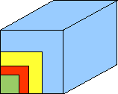



Principle
To translate directly the functional analysis
  Re-usable and nested Modules
  Built with sections
Basic component of a PLC program
  LD, IL, ST, FBD or SFC with macro-steps
  Uses function libraries of instructions, EFBs, DFBs
User function block « an encapsulated program »
  I/O Interface can be parametered
  Uses Unlocated Variables: Public and private
  Code created in LD, ST, IL, FBD
Basic and standard instructions
Functional module
Section
EFBs & DFBs
Basic instruction
Notes:
Function modules :
can be used to structure the application according to control system functions and sub-functions.
A function module is a group of program elements (sections, events, macro-steps, animation tables, etc) for creating a control system function.

Slide 16
Functional View
Station folder allows to :
  Access, create or delete functional modules
  Export or import a global project
  Access to properties of project
  Protect the project
Functional module folders include :
  Program folder made up of one or more sections
  Table folder made up of one or more animation tables
  Screen folder made up of one or more operator screens
  Lower-level function modules

Slide 17
Creating functional modules
Creation
  directly
  via an import
Creating a new functional module
Adding/creating a section, an event, a flow-chart, an table or a screen
  Case 1 : The section, event or chart already exists in the structural view
  Simply drag and drop to position the section on the function module
  Case 2 : The section, event or chart does not exist in the structural view
  When the section is created from the functional view : the associated task must be specified at the time of creation for sections
Notes:
A function module is made up of :
A name : 32 characters. This name must be unique in the application
A descriptive file (256 characters), not memorized in the PLC but memorized in the .STU file in the application
Function submodules: lower-level function modules
Associated code modules: sections, events, SFC modules
Associated animation tables
Associated operator screens

Slide 18
Managing
Moving a functional module (simply drag and drop to move a function module)
Detaching a function module (To cut the links between the functional module and its associated objects (program, tables, screens))
Deleting one or more function modules
  without deletion of code modules and animation tables
  with deletion of code modules and animation tables
Importing / exporting a function module
  without reassignment
  with reassignment using the Import Wizard
Protecting program sections included in a function module
Activation conditions for sections included in a function module (force to 0, force to 1, cancel forcing)

Slide 19
Functions
Accessible from the structure view and function view
Export function
  To copy a file, a part or all of your project program
  Generates a file that contains unprotected data and references to protected data
  Export type determined by the extension file (for example : *.XDB to export a DFB type, etc.)
Import function
  To retrieve into your project part or all of a project program
  Automatic storage of the application before
  Management of conflicts (if an element already exits during the import)
  Following an import mandatory to conform the imported data (analysis and generation).
Notes:
A message tells in the Output Window that import or export is complete. If errors occur during import or export, a message inform of these.

Slide 20
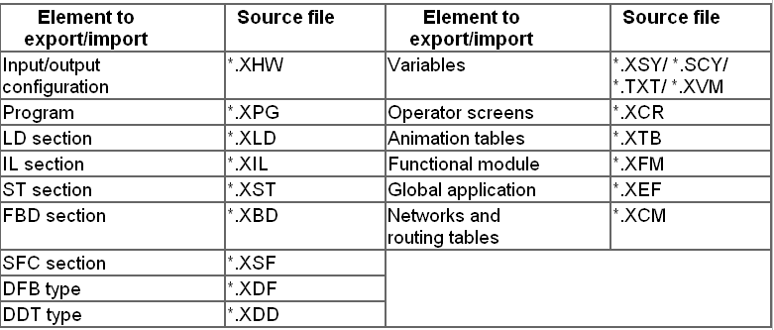
Files

Slide 21
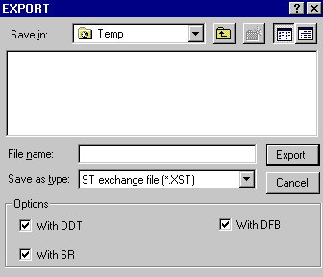
Export function
Via dialog box
  Select the element to export
  Right-click => Export
  Select folder and file name
  If options are available, select its to export in the same time
  Click on Export to validate
Notes :
  Section protected in read/write mode cannot be exported.
  A DFB protected can be exported but file *.XDF is encoded.
Notes:
Available options as a function of the elements to be exported :
Export available :

Slide 22
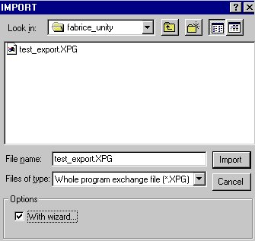
Import function
Via dialog box
  Select the place of the element to be imported
  Right-click => Import
  Save the application
  Select folder and file to be imported
  Select or not the option to import with wizard
  Click on Import to validate
Notes :
  To import a global application, open and select a *.XEF file
  Option to import with Wizard

Slide 23
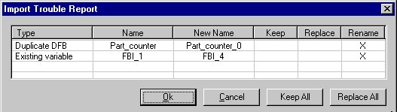
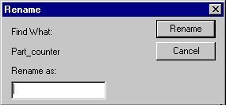
Conflicts management
Import’s Trouble Report dialog box (if an element alreaday exits)
Variable management :
  Keep All
  Replace All
  Rename : double click on Rename column for an element

Slide 24
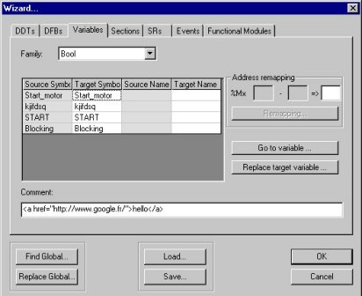
Wizard
During the import, possible to be assisted in order to facilitate the reassignments of elements
Select import option "with Wizard"
one tab for each element type (DDTs, DFBs, variables, Sections, SRs, Events, Functional modules)
Common commands
  Find and Replace (possible to replace a character string)
  Load and Save

Slide 25
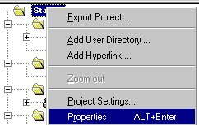
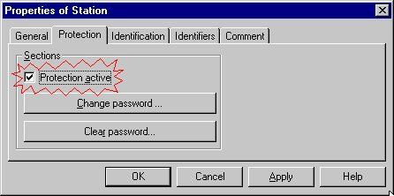
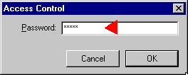
Global protection
Activate the global protection of the sections
1 - Right-click and select Properties
2 - Activate the protection
3 - Enter a password
Notes:
Global protection
The project protection function is accessible from the Properties screen of the project in offline mode. This function is used to protect the program sections.
Note: The protection cannot be activated if there is no password. The protection is active each time a password-protected project is opened.
To have a global protection of the application, select in the project settings "Without" in Upload Information window

Slide 26
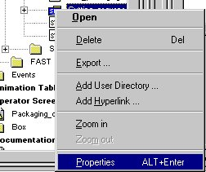
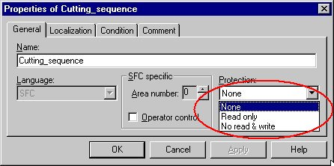
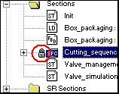
Protection of sections
Protect a section (if the global protection is activated)
2 - Select the protection :
Read only
Read/Write
1 - Right-click and select Properties on the section
Notes:
Display at each section level:
Blank: no protection
Padlock unlocked:
section protected
protection deactivated
Padlock locked:
section protected
protection activated

Slide 27
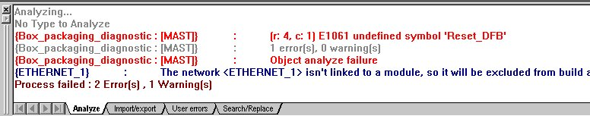
Analyse the application
Allows the detection of errors generated for each application modifications
All types of errors detected during the analysis phase are automatically shown on the screen in the output window
This message, which appears in inverted commas in the output window allows you to directly access the part of the program to be corrected by double click
Notes:
The output sheets display the results of an executed action or error messages. Double-clicking on an error message to open the respective Editor and mark the "faulty" entry.
New error entries are displayed in red, already checked errors are displayed in underlined blue.
New warning entries are displayed in blue, already checked warnings are displayed in underlined blue.

Slide 28

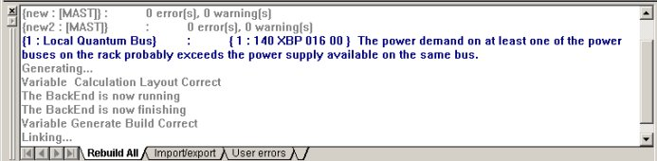
Build
The drop down menu "Build" allows access to the software tools used to generate a project.
  Rebuild all Project
    Creates a file that can be downloaded to the PLC or the PLC Simulator
  Build Project
    Takes into account the changes made to an existing project
Output Window
Notes:
Impossible to build or rebuild all the project if an error is present during the analyze.

